Slide 1
Amino acids Dr. Saad hussein
What are Amino Acids?
A. A. are organic carboxylic acids and it the building blocks(monomer) of proteins and peptides.
  How important are they?
  proteins; enzymes, hormones → direct and regulate metabolism in the body. For examples:
  contractile proteins in muscle → movement.
  In bone →Collagen
  In the bloodstream →hemoglobin, plasma albumin and immunoglobulin → fight infectious bacteria and viruses.
  20 amino-acids/ proteins/ coded by DNA
  (these amino acids are standard A. A.(natural A. A.)

Slide 2
  20 amino acids are divided into two groups:
  1- proteogenic, or proteinogenic amino acids(normally components of proteins)
  2. nonproteogenic or nonproteinogenic amino acids (not components of proteins)
  Functions of amino acids
  - Structural Function
  - Peptides, proteins (enzymes, plasma and tissue proteins)
  - Hormones .
  - Histamine is the mediator of allergic reactions.
  - Neurotransmitters (glycine , glutamate)
  - Health and growth
  From where Amino acid come ?
  - present in body/cells)
  - Foods
  - Synthesized from other metabolic compounds inside the body
  - Degradation of proteins inside the cell

Slide 3
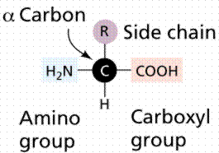
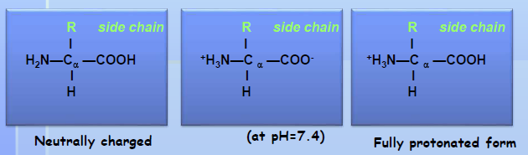
Structure of proteogenic amino acids:
All protein amino acids are L-amino acids bearing an NH₂ and COOH groups on the carbon at α-position:
Tetrahedral carbon atom) α- carbon ) attached to:
1. carboxylic acid group -COOH
2. amino group -NH₂
3. R-groups, that distinguish one amino acid from another; except
glycine where the R-group is H
4. H atom
Forms of amino acids:

Slide 4
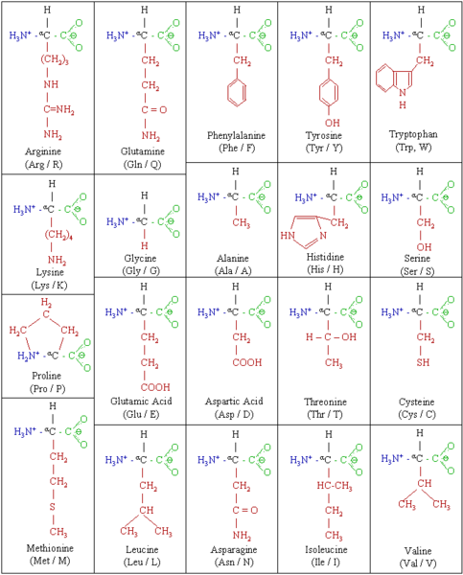
20 Amino acids

Slide 5
Amino Acids Abbreviations
One letter (examples)
Alanine, A
Glycine, G
Aspartate, D
Aspargine, N
Glutamate, E
Glutamine, Q
Tyrosine, Y
Tryptophan, W
Three letter (examples)
Alanine, Ala
Glycine, Gly
Aspartate, Asp
Aspargine, Asn
Glutamate, Glu
Glutamine, Gln
Tyrosine, Tyr
Tryptophan, Trp
Importance of functional groups (R)
Unique to each amino acid
Determine the role that the amino acid plays in a protein
Different amino acids have interesting properties because they have a variety of structural parts which result in different polarities and solubility.
Classifications of amino acids:
1. Chemical classification:
  - According functional group ( -COOH and -NH₂)
  - According to charge and polarity of their side chain (R)
2. Nutritional classification
A- Essential amino acid B- Non essential amino acid

Slide 6
Classifications of amino acids:
1. Chemical classification:
  - According functional group ( -COOH and -NH₂)
  - According to charge and polarity of their side chain (R)
2. Nutritional classification
A- Essential amino acid B- Non essential amino acid
3. Biological or metabolic classification
  - Glucogenic amino acids
  - Ketogenic amino acid
  - Both glucogenic and ketogenic amino acids

Slide 7
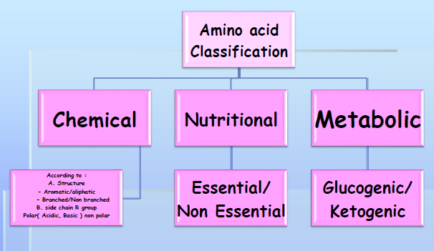
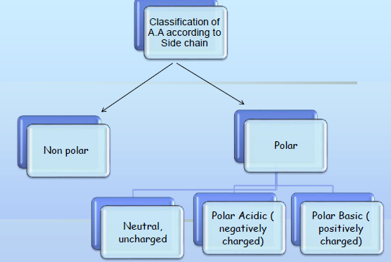

Slide 8
Classification of amino acid at pH 6-7
Non Polar least soluble
  R= H⁺, CH₃, alkyl, aromatic.
  ( 9 amino acids in this group)
Polar Uncharged more soluble
  R = –CH₂OH, –CH₂SH, C–NH₂,
(polar groups with hydroxyl–OH,
sulfur -SH, Amide group)
(6 amino acids in this group)
Acidic/ Polar:
  R= -COOH
  ( 2 amino acids in this group)
Basic/ Polar:
  R= -NH₂
  ( 3 amino acids in this group)

Slide 9
Polar Side Chains
These are more soluble in water than the Non polar( Hydrophilic).
have an uneven distribution of electrons, such as acids and bases.
Side chains which have various functional groups such as Sulfur, amides, alcohols will impart a more polar character to the amino acid.
Polar Uncharged Side Chains (Hydrophylic)
These A.A. have zero net charge at neutral pH.
1. Ser, Thr, Tyr ……. hydroxyl group …….………. hydrogen bond.
2. ASP, Glu …….. Carbonyl group , amide group……… hydrogen bond.
3. Cys ……….. Sulfhydryl group(-SH) ………….. disulfide bond.
Polar Uncharged Side Chains (Hydrophylic)

Slide 10
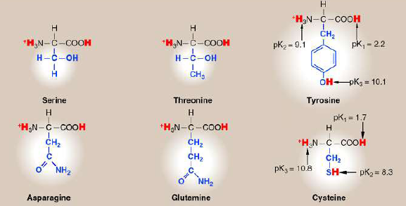
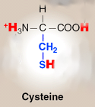
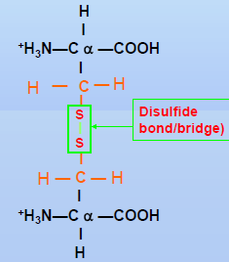
Polar Uncharged Side Chains (Hydrophylic)
Polar Uncharged Side Chains
Disulfide bonds:
  Cysteine (-SH group)
  2 Cysteine (2 –SH groups, become oxidized
  to give S-S disulfied bond)
  Play important role in protein stability

Slide 11
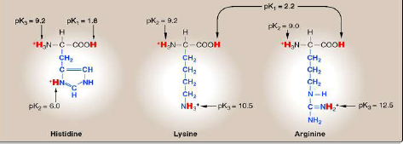
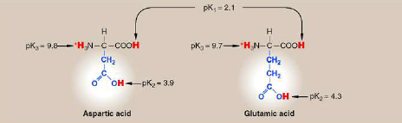
Basic Side Chains
Contains more than one –NH₂ group.
Proton acceptors.
(+ve) at physiological pH.
Acidic Side Chains
Contains more than one –COOH group.
Proton donors.
(-ve) at physiological pH.

Slide 12
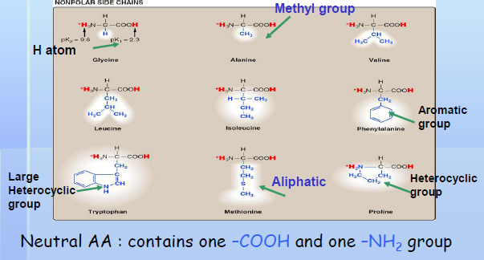
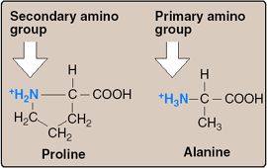
Nonpolar Side Chains
Each of these A.A. has a nonpolar side chain that does not bind or give off protons or participate in hydrogen or ionic bonds.
have an even distribution of electrons.
Proline
One of the 20 AA called proline is not an amino acid
It is an Imino acid as it contains imino group (-NH).
It has a secondary amino group.
Fibrous structures of collagen.

Slide 13
Other Classifications of amino acids
1. Essential
2. Non essential
1. Glucogenic: gives glucose
2. Ketogenic: gives ketone bodies
Can not be synthesized by humans body (have to get them from diet)
Their deficiencies affect growth, health, protein synthesis
10 amino acids:
Essential AA in Humans
Isoleucine
Lysine
Methionine
Leucine
Valine
Threonine
Phenylalanine
Tryptophan
Arginine*
Histidine*
* in children

Slide 14
Non-Essential AA in Humans
10 amino acids that can be formed from a-keto acids by transamination and subsequent reactions
Alanine
Glycine
Serine
Proline
Glutamate
Glutamine
Aspartate
Asparagine
Cysteine (from Met*)
Tyrosine (from Phe*)
* Essential Amino acids

Slide 15
